Slide 1
Spiritualism Exposed
The Great Controversy Ch. 31-34
Lesson 10, 2nd Quarter 2024

Slide 2
16 For the Lord himself shall descend from heaven with a shout, with the voice of the archangel, and with the trump of God: and the dead in Christ shall rise first:
17 Then we which are alive and remain shall be caught up together with them in the clouds, to meet the Lord in the air: and so shall we ever be with the Lord.
MEMORY TEXT: 1 Thessalonians 4:16-17

Slide 3
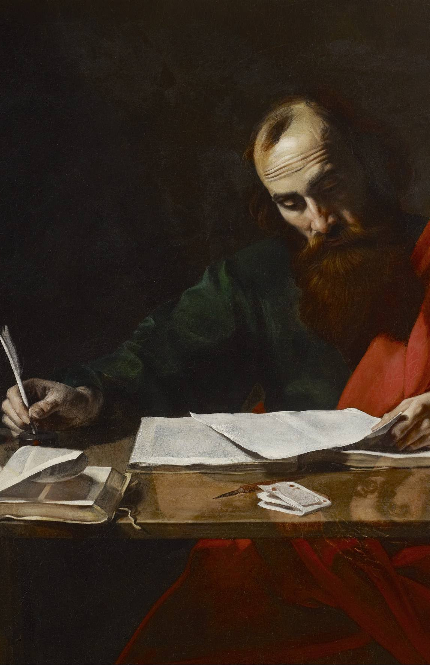
2 Thessalonians 2:1-12
Now we beseech you, brethren, by the coming of our Lord Jesus Christ, and by our gathering together unto him,
2 That ye be not soon shaken in mind, or be troubled, neither by spirit, nor by word, nor by letter as from us, as that the day of Christ is at hand.

Slide 4
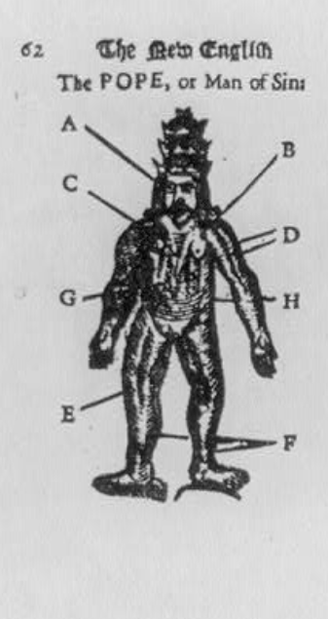
2 Thessalonians 2:3-12
3 Let no man deceive you by any means: for that day shall not come, except there come a falling away first, and that man of sin be revealed, the son of perdition;
4 Who opposeth and exalteth himself above all that is called God, or that is worshipped; so that he as God sitteth in the temple of God, shewing himself that he is God.

Slide 5
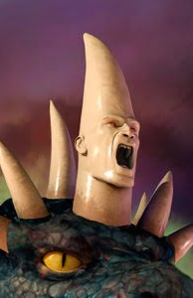
2 Thessalonians 2:5-12
5 Remember ye not, that, when I was yet with you, I told you these things?
6 And now ye know what withholdeth that he might be revealed in his time.
7 For the mystery of iniquity doth already work: only he who now letteth will let, until he be taken out of the way.

Slide 6
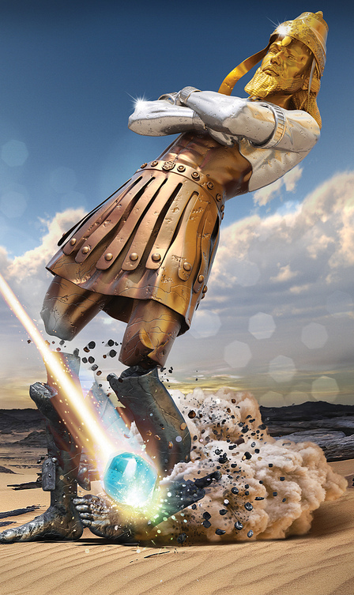
2 Thessalonians 2:8-12
8 And then shall that Wicked be revealed, whom the Lord shall consume with the spirit of his mouth, and shall destroy with the brightness of his coming:
9 Even him, whose coming is after the working of Satan with all power and signs and lying wonders,

Slide 7

2 Thessalonians 2:10-12
10 And with all deceivableness of unrighteousness in them that perish; because they received not the love of the truth, that they might be saved.

Slide 8
2 Thessalonians 2:10-12
10 And with all deceivableness of unrighteousness in them that perish; because they received not the love of the truth, that they might be saved.
John 14:6-7
6 Jesus saith unto him, I am the way, the truth, and the life: no man cometh unto the Father, but by me.
7 If ye had known me, ye should have known my Father also: and from henceforth ye know him, and have seen him.

Slide 9
2 Thessalonians 2:11-12
11 And for this cause God shall send them strong delusion, that they should believe a lie:
12 That they all might be damned who believed not the truth, but had pleasure in unrighteousness.

Slide 10
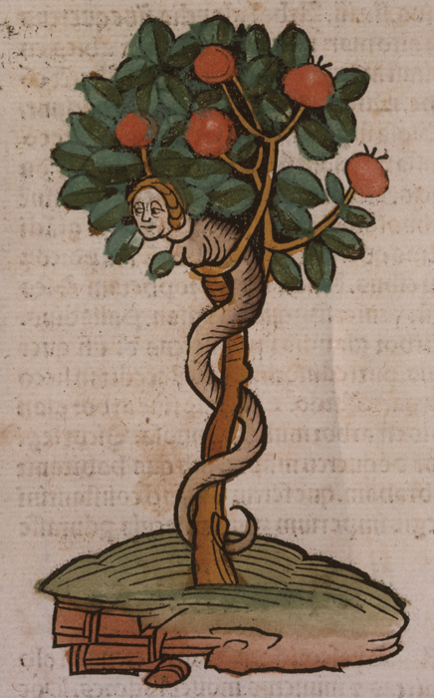
Genesis 4:4-6
4 And the serpent said unto the woman, Ye shall not surely die:
5 For God doth know that in the day ye eat thereof, then your eyes shall be opened, and ye shall be as gods, knowing good and evil.

Slide 11
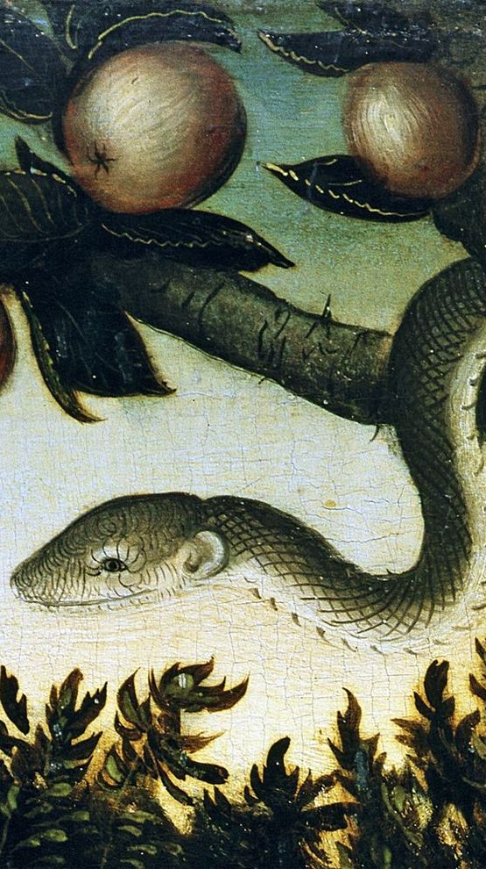
Genesis 4:6
6 And when the woman saw that the tree was good for food, and that it was pleasant to the eyes, and a tree to be desired to make one wise, she took of the fruit thereof, and did eat, and gave also unto her husband with her; and he did eat.

Slide 12
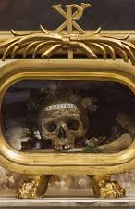
The Great Controversy P. 533
The only one who promised Adam life in disobedience was the great deceiver. And the declaration of the serpent to Eve in Eden—“Ye shall not surely die”—was the first sermon ever preached upon the immortality of the soul. Yet this declaration, resting solely upon the authority of Satan, is echoed from the pulpits of Christendom and is received by the majority of mankind as readily as it was received by our first parents.

Slide 13
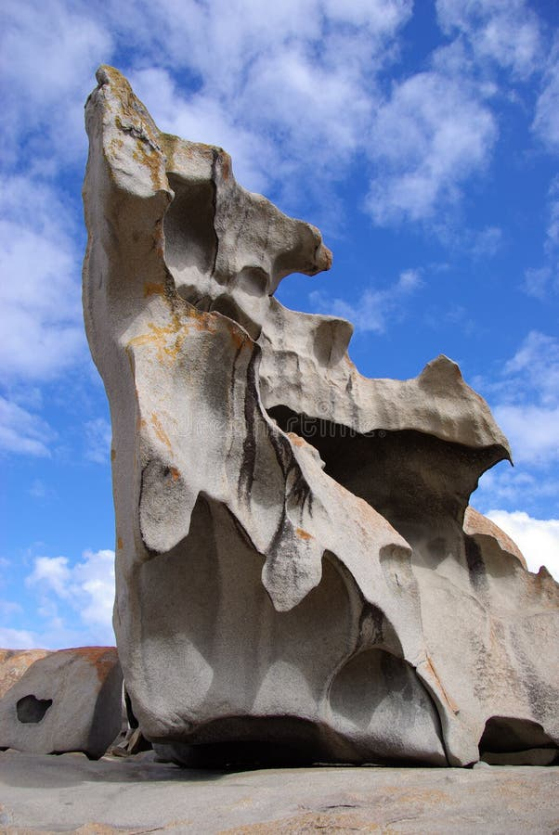
Ezekiel 18:20
20 The soul that sinneth, it shall die. The son shall not bear the iniquity of the father, neither shall the father bear the iniquity of the son: the righteousness of the righteous shall be upon him, and the wickedness of the wicked shall be upon him.

Slide 14
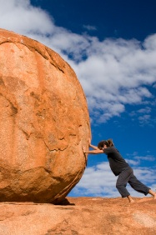
Isaiah 3:10-11
10 Say ye to the righteous, that it shall be well with him: for they shall eat the fruit of their doings.
11 Woe unto the wicked! it shall be ill with him: for the reward of his hands shall be given him.

Slide 15
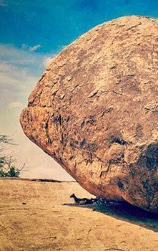
Ecclesiastes 8:12-13
12 Though a sinner do evil an hundred times, and his days be prolonged, yet surely I know that it shall be well with them that fear God, which fear before him:
13 But it shall not be well with the wicked, neither shall he prolong his days, which are as a shadow; because he feareth not before God.

Slide 16
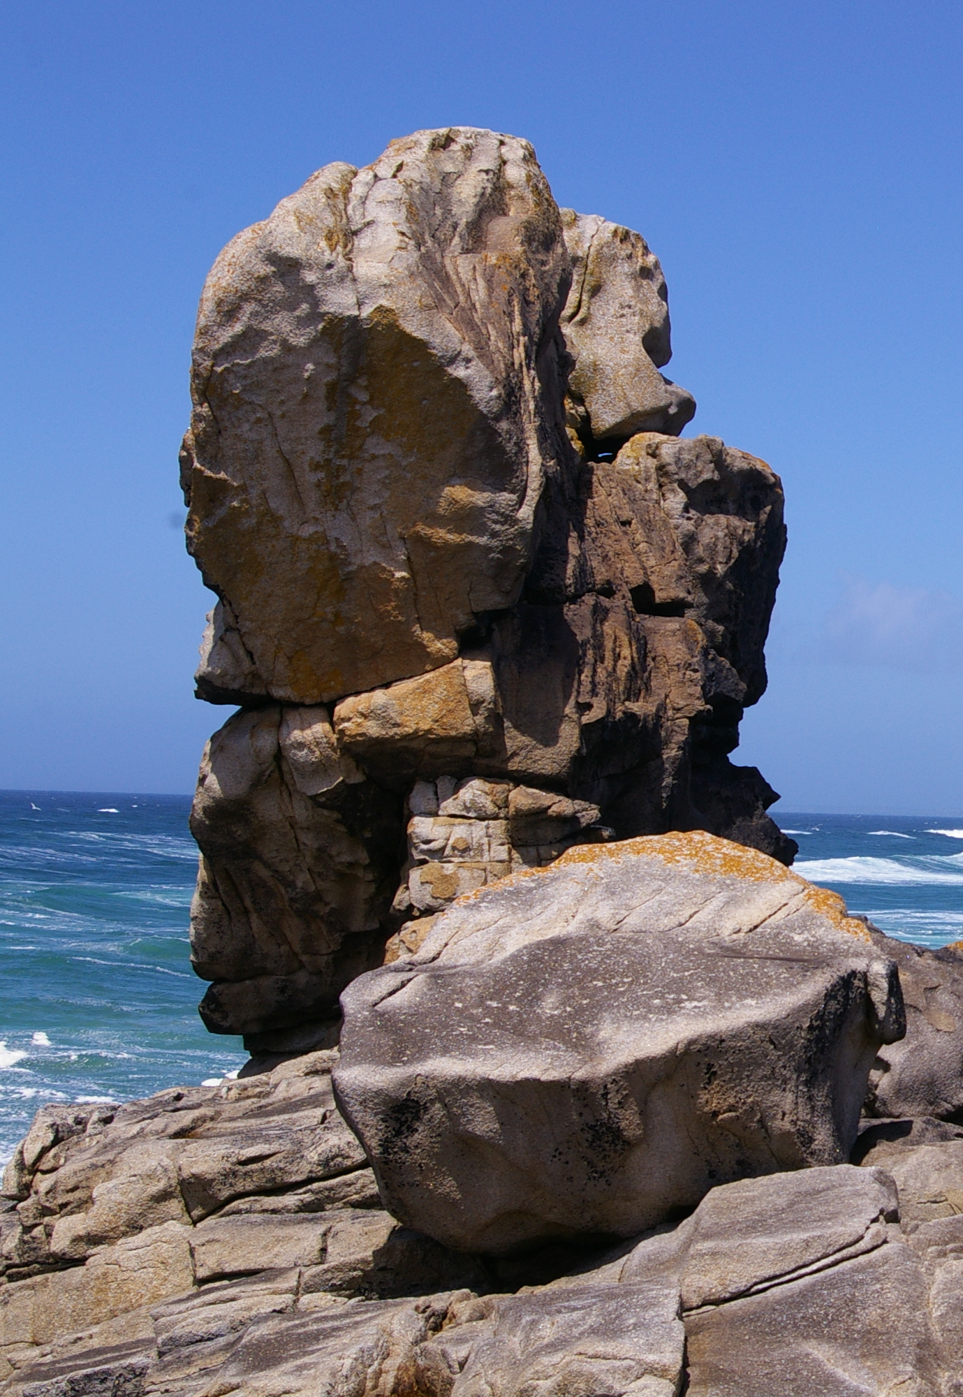
Romans 2:5-6
5 But after thy hardness and impenitent heart treasurest up unto thyself wrath against the day of wrath and revelation of the righteous judgment of God;
6 Who will render to every man according to his deeds:

Slide 17
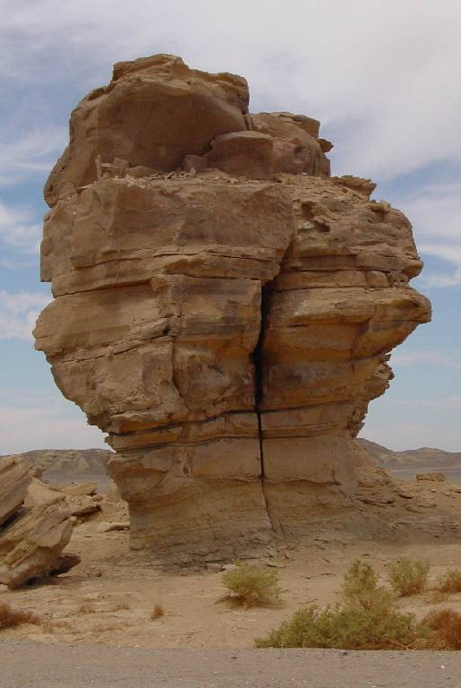
Ephesians 5:5-6
5 For this ye know, that no whoremonger, nor unclean person, nor covetous man, who is an idolater, hath any inheritance in the kingdom of Christ and of God.
6 Let no man deceive you with vain words: for because of these things cometh the wrath of God upon the children of disobedience.

Slide 18
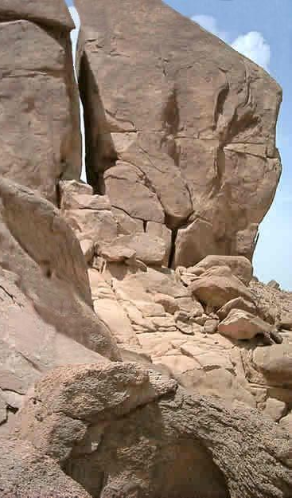
Exodus 34:6-7
6 And the Lord passed by before him, and proclaimed, The Lord, The Lord God, merciful and gracious, longsuffering, and abundant in goodness and truth,
7 Keeping mercy for thousands, forgiving iniquity and transgression and sin, and that will by no means clear the guilty; visiting the iniquity of the fathers upon the children, and upon the children's children, unto the third and to the fourth generation.

Slide 19

Romans 6:23
23 For the wages of sin is death; but the gift of God is eternal life through Jesus Christ our Lord.

Slide 20
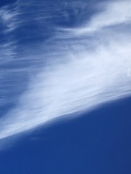
Psalm 146:4
4 His breath goeth forth, he returneth to his earth; in that very day his thoughts perish.

Slide 21

Ecclesiastes 9:5-6
5 For the living know that they shall die: but the dead know not any thing, neither have they any more a reward; for the memory of them is forgotten.
6 Also their love, and their hatred, and their envy, is now perished; neither have they any more a portion for ever in any thing that is done under the sun.

Slide 22

Ecclesiastes 9:10
10 Whatsoever thy hand findeth to do, do it with thy might; for there is no work, nor device, nor knowledge, nor wisdom, in the grave, whither thou goest.

Slide 23

Isaiah 38:18-19
18 For the grave cannot praise thee, death can not celebrate thee: they that go down into the pit cannot hope for thy truth.
19 The living, the living, he shall praise thee, as I do this day: the father to the children shall make known thy truth.

Slide 24
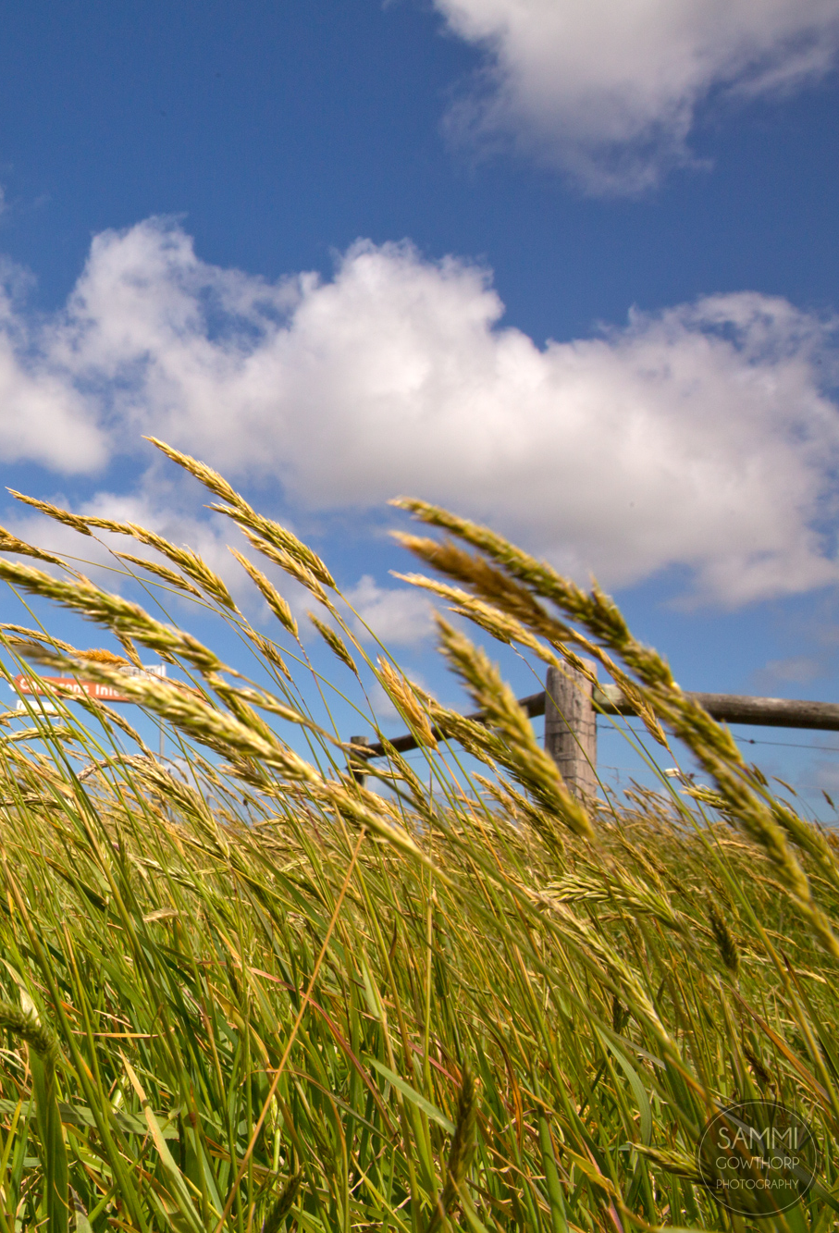
Psalm 115:17
17 The dead praise not the Lord, neither any that go down into silence.

Slide 25
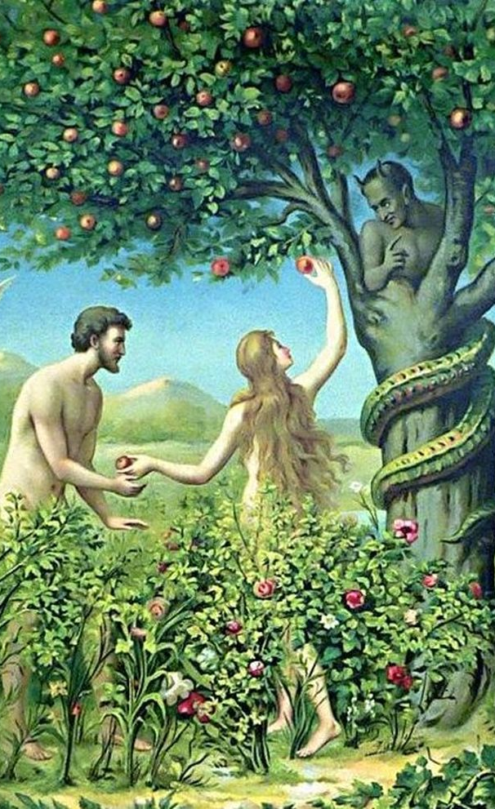
The Great Controversy P. 554
Satan beguiles men now as he beguiled Eve in Eden by flattery, by kindling a desire to obtain forbidden knowledge, by exciting ambition for self-exaltation. It was cherishing these evils that caused his fall, and through them he aims to compass the ruin of men. “Ye shall be as gods,” he declares, “knowing good and evil.” Genesis 3:5.

Slide 26
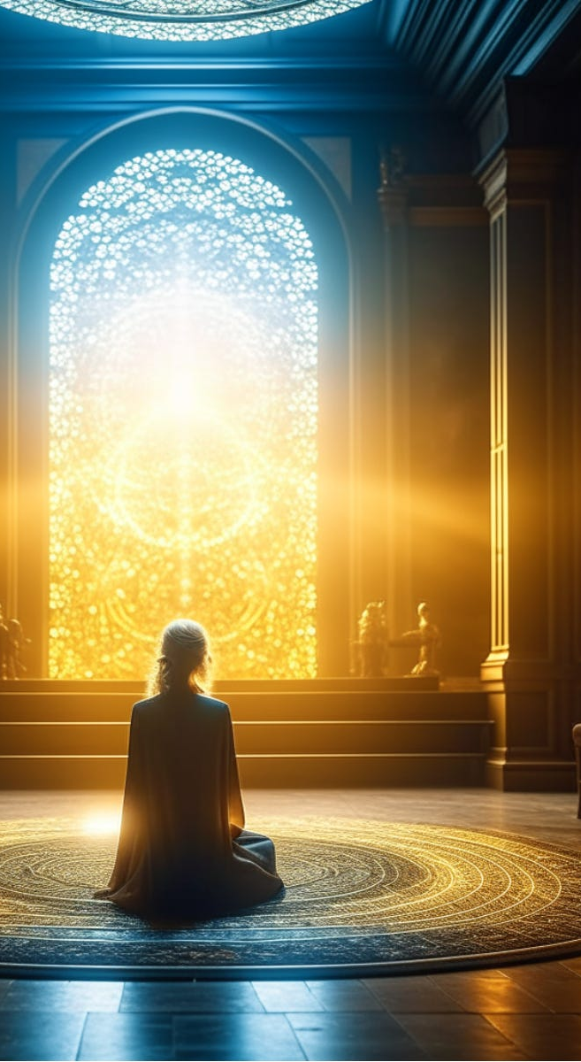
The Great Controversy P. 554
Spiritualism teaches “that man is the creature of progression; that it is his destiny from his birth to progress, even to eternity, toward the Godhead.” And again: “Each mind will judge itself and not another.” “The judgment will be right, because it is the judgment of self.... The throne is within you.”

Slide 27

The Great Controversy P. 554
Thus, in place of the righteousness and perfection of the infinite God, the true object of adoration; in place of the perfect righteousness of His law, the true standard of human attainment, Satan has substituted the sinful, erring nature of man himself as the only object of adoration, the only rule of judgment, or standard of character. This is progress, not upward, but downward.

Slide 28
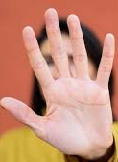
Leviticus 19:31
31 Regard not them that have familiar spirits, neither seek after wizards, to be defiled by them: I am the Lord your God.

Slide 29
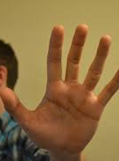
Leviticus 20:27
27 A man also or woman that hath a familiar spirit, or that is a wizard, shall surely be put to death: they shall stone them with stones: their blood shall be upon them.

Slide 30

Isaiah 8:19
19 And when they shall say unto you, Seek unto them that have familiar spirits, and unto wizards that peep, and that mutter: should not a people seek unto their God? for the living to the dead?

Slide 31
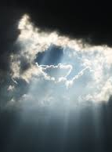
Isaiah 5:20-21
20 Woe unto them that call evil good, and good evil; that put darkness for light, and light for darkness; that put bitter for sweet, and sweet for bitter!
21 Woe unto them that are wise in their own eyes, and prudent in their own sight!

Slide 32
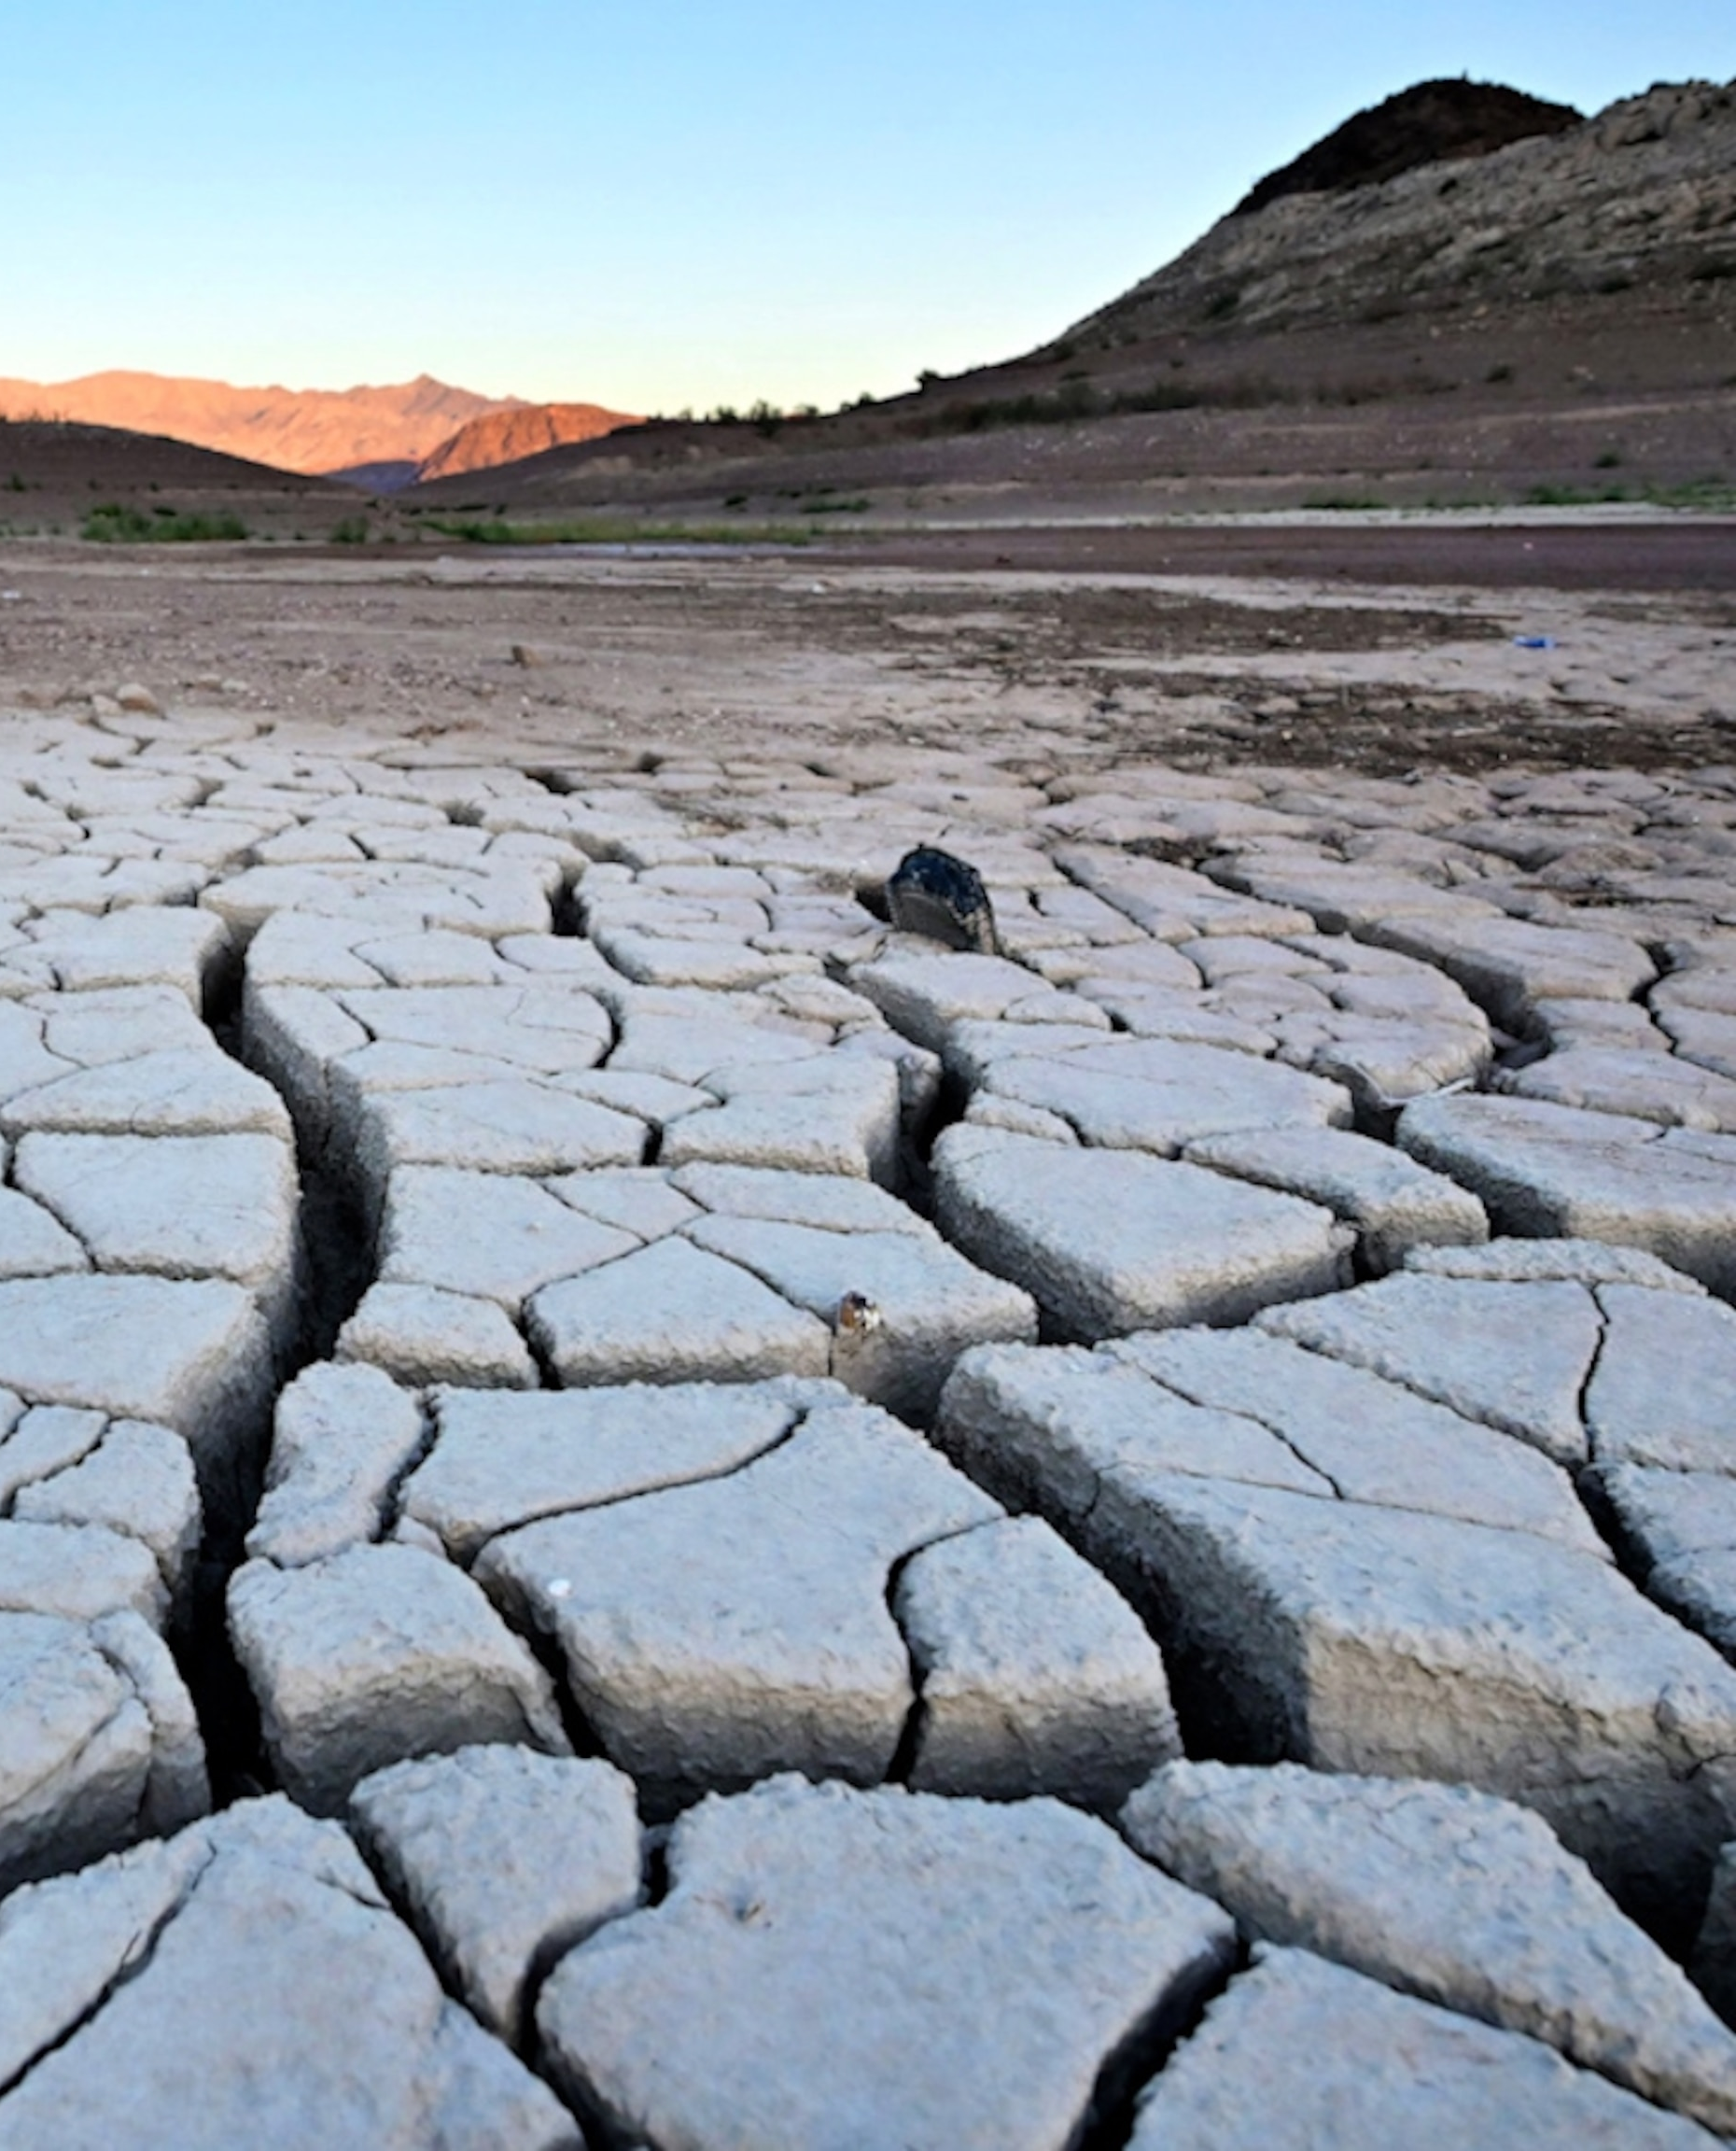
Our Final Conflict: Revelation 16:12-14
12 And the sixth angel poured out his vial upon the great river Euphrates; and the water thereof was dried up, that the way of the kings of the east might be prepared.

Slide 33
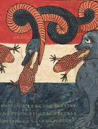
Our Final Conflict: Revelation 16:12-14
13 And I saw three unclean spirits like frogs come out of the mouth of the dragon, and out of the mouth of the beast, and out of the mouth of the false prophet.

Slide 34
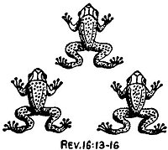
Our Final Conflict: Revelation 16:12-14
14 For they are the spirits of devils, working miracles, which go forth unto the kings of the earth and of the whole world, to gather them to the battle of that great day of God Almighty.

Slide 35
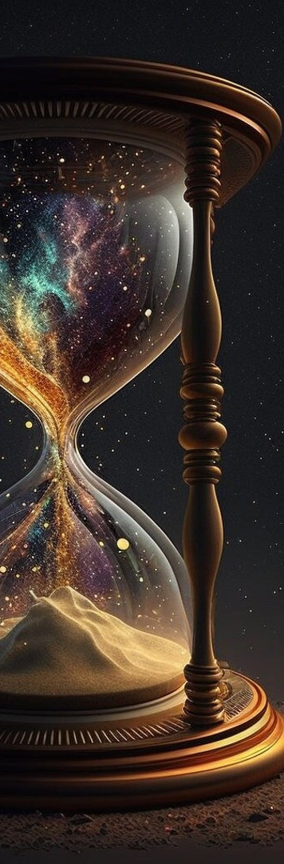
The Great Controversy P. 560
Just before us is “the hour of temptation, which shall come upon all the world, to try them that dwell upon the earth.” Revelation 3:10. All whose faith is not firmly established upon the word of God will be deceived and overcome. Satan “works with all deceivableness of unrighteousness” to gain control of the children of men, and his deceptions will continually increase.

Slide 36
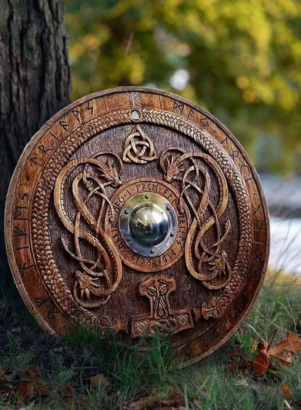
The Great Controversy P. 560
But he can gain his object only as men voluntarily yield to his temptations. Those who are earnestly seeking a knowledge of the truth and are striving to purify their souls through obedience, thus doing what they can to prepare for the conflict, will find, in the God of truth, a sure defense. “

Slide 37

Isaiah 28:9-15
9 Whom shall he teach knowledge? and whom shall he make to understand doctrine? them that are weaned from the milk, and drawn from the breasts.
10 For precept must be upon precept, precept upon precept; line upon line, line upon line; here a little, and there a little:

Slide 38

Isaiah 28:9-15
The priests and prophets whose business it was to teach the people were themselves misled, and therefore in no position to carry out their responsibilities. Jesus referred to them as ‘blind guides’(Matt. 23:16). The only remedy for spiritual blindness is spiritual “eyesalve” (Rev. 3:18), but this they refused to purchase from the only Merchant who offered it for sale. Herein lies a sober warning for the church today.
9 Whom shall he teach knowledge? and whom shall he make to understand doctrine? them that are weaned from the milk, and drawn from the breasts.
10 For precept must be upon precept, precept upon precept; line upon line, line upon line; here a little, and there a little:

Slide 39
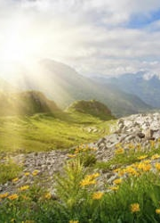
Isaiah 28:11-15
11 For with stammering lips and another tongue will he speak to this people.
12 To whom he said, This is the rest wherewith ye may cause the weary to rest; and this is the refreshing: yet they would not hear.

Slide 40
Isaiah 28:11-15
Only by hearing and obeying the revealed will of God may true rest be found. Jesus invited the weary to come to Him, and promised to give them rest (Matt. 11:28). But Israel and Judah refused to listen, and thus did not find the rest that might have been theirs. God had spoken to His people clearly and simply, and they were without excuse. But His counsels, which were intended to bring blessing, now stood to witness against them.
11 For with stammering lips and another tongue will he speak to this people.
12 To whom he said, This is the rest wherewith ye may cause the weary to rest; and this is the refreshing: yet they would not hear.

Slide 41

Isaiah 28:13-15
13 But the word of the Lord was unto them precept upon precept, precept upon precept; line upon line, line upon line; here a little, and there a little; that they might go, and fall backward, and be broken, and snared, and taken.
14 Wherefore hear the word of the Lord, ye scornful men, that rule this people which is in Jerusalem.

Slide 42
Isaiah 28:13-15
The leaders of God’s people scorned His instruction and scoffed at the warnings given them. Isaiah was addressing the very men who in their worldly wisdom had derided his teachings and persisted in advocating a policy that would result in national rain. In words of bitter reproach these leaders are now taken to task and told in unmistakable language of the fate that awaits them.
13 But the word of the Lord was unto them precept upon precept, precept upon precept; line upon line, line upon line; here a little, and there a little; that they might go, and fall backward, and be broken, and snared, and taken.
14 Wherefore hear the word of the Lord, ye scornful men, that rule this people which is in Jerusalem.

Slide 43

Isaiah 28:11-15
15 Because ye have said, We have made a covenant with death, and with hell are we at agreement; when the overflowing scourge shall pass through, it shall not come unto us: for we have made lies our refuge, and under falsehood have we hid ourselves:

Slide 44
Isaiah 28:11-15
The scoffers of v. 14 are speaking, and this is their scornful reply to the solemn message of warning. Isaiah had warned that these men would “fall backward, and be broken, and snared, and taken” (v. 13). But the scoffers only laughed and expressed unconcern. Death, they say, has agreed to let them live on in spite of the decrees of Heaven. “We will not surely die for our misdeeds!” That’s Satan’s lie.
15 Because ye have said, We have made a covenant with death, and with hell are we at agreement; when the overflowing scourge shall pass through, it shall not come unto us: for we have made lies our refuge, and under falsehood have we hid ourselves:

Slide 45
Isaiah 28:15
15 Because ye have said, We have made a covenant with death, and with hell are we at agreement; when the overflowing scourge shall pass through, it shall not come unto us: for we have made lies our refuge, and under falsehood have we hid ourselves:
She’ol (here translated “hell”) is figuratively presented as a foreign nation with which the “scornful men” had made a treaty. “Death” is its king. So vile and reprobate were these leaders of the professed people of God that they openly scorned truth and righteousness.

Slide 46
Isaiah 28:15
Wicked king Ahaz, the father of Hezekiah, made a league with Assyria and openly accepted the Assyrian gods and worship; in fact he replaced the altar of the Lord in Jerusalem with a heathen altar (2 Kings 16:7-18). By serving the devil they hoped to escape his scourges.
15 Because ye have said, We have made a covenant with death, and with hell are we at agreement; when the overflowing scourge shall pass through, it shall not come unto us: for we have made lies our refuge, and under falsehood have we hid ourselves:

Slide 47
Isaiah 28:15
15 Because ye have said, We have made a covenant with death, and with hell are we at agreement; when the overflowing scourge shall pass through, it shall not come unto us: for we have made lies our refuge, and under falsehood have we hid ourselves:
These scoffers speak of their own beliefs and policies as “lies.” They know that they are speaking falsehoods, but for reasons of their own they would rather deal in falsehood than in truth.

Slide 48

The Great Controversy P. 560
In the class here described are included those who in their stubborn impenitence comfort themselves with the assurance that there is to be no punishment for the sinner; that all mankind, it matters not how corrupt, are to be exalted to heaven, to become as the angels of God.

Slide 49
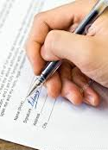
The Great Controversy P. 560
But still more emphatically are those making a covenant with death and an agreement with hell, who renounce the truths which Heaven has provided as a defense for the righteous in the day of trouble, and accept the refuge of lies offered by Satan in its stead—the delusive pretensions of spiritualism.

Slide 50

The Great Controversy P. 561
Marvelous beyond expression is the blindness of the people of this generation. Thousands reject the word of God as unworthy of belief and with eager confidence receive the deceptions of Satan. Skeptics and scoffers denounce the bigotry of those who contend for the faith of prophets and apostles, and they divert themselves by holding up to ridicule the solemn declarations of the Scriptures concerning Christ and the plan of salvation, and the retribution to be visited upon the rejecters of the truth.

Slide 51
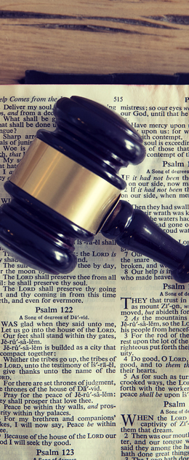
The Great Controversy P. 561
They affect great pity for minds so narrow, weak, and superstitious as to acknowledge the claims of God and obey the requirements of His law. They manifest as much assurance as if, indeed, they had made a covenant with death and an agreement with hell—as if they had erected an impassable, impenetrable barrier between themselves and the vengeance of God. Nothing can arouse their fears.

Slide 52
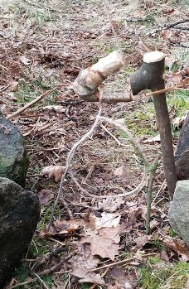
The Great Controversy P. 561
Nothing can arouse their fears. So fully have they yielded to the tempter, so closely are they united with him, and so thoroughly imbued with his spirit, that they have no power and no inclination to break away from his snare.

Slide 53

The Great Controversy P. 561
Satan has long been preparing for his final effort to deceive the world. The foundation of his work was laid by the assurance given to Eve in Eden: “Ye shall not surely die.” “In the day ye eat thereof, then your eyes shall be opened, and ye shall be as gods, knowing good and evil.” Genesis 3:4, 5. Little by little he has prepared the way for his masterpiece of deception in the development of spiritualism.

Slide 54
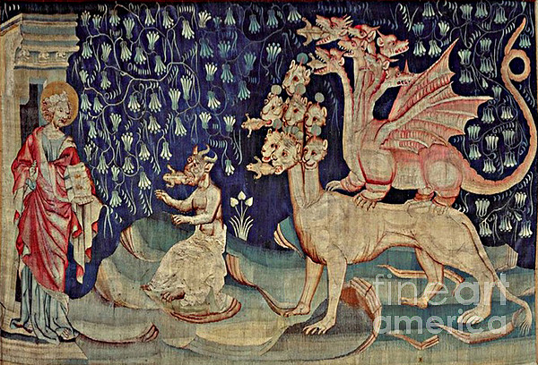
The Great Controversy P. 561
He has not yet reached the full accomplishment of his designs; but it will be reached in the last remnant of time. Says the prophet: “I saw three unclean spirits like frogs; ... they are the spirits of devils, working miracles, which go forth unto the kings of the earth and of the whole world, to gather them to the battle of that great day of God Almighty.” Revelation 16:13, 14.

Slide 55

The Great Controversy P. 561
Except those who are kept by the power of God, through faith in His word, the whole world will be swept into the ranks of this delusion. The people are fast being lulled to a fatal security, to be awakened only by the outpouring of the wrath of God.

Slide 56
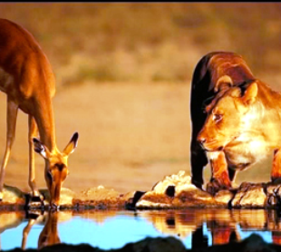
1 Peter 5:8
8 Be sober, be vigilant; because your adversary the devil, as a roaring lion, walketh about, seeking whom he may devour:

Slide 57

Thank You!
Happy Sabbath!!

